Slide 1

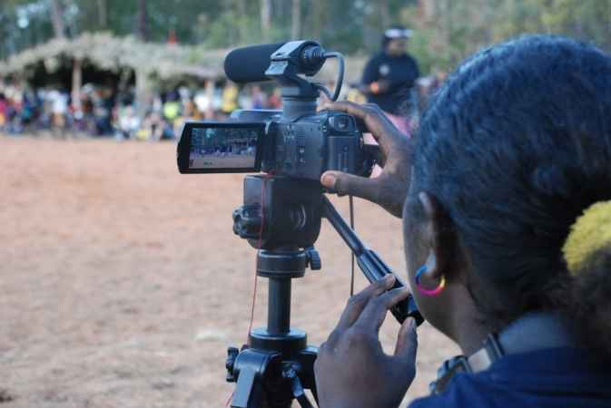
VET Program development & delivery at NTOEC
Certificate II Creative Industries (Media)
A nationally recognised skills based curriculum that prepares students for a career pathway into a related field of employment or further study such as the Certificate III or IV Creative Industries at Charles Darwin University
The demonstration and repeated application of competency is a feature
of the satisfactory completion of units
It is largely concerned with skill development in:
  Digital Photography and Imaging
  Sound Recording and Editing
  Graphic Design
  Film making and Editing
There are also core units covering general skill
development in teamwork, problem solving,
career pathways, OHS and general literacy
Learner Guide

Slide 2
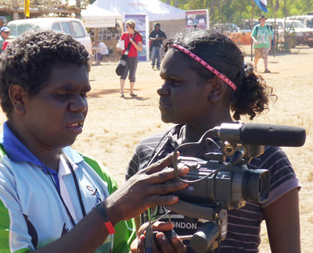
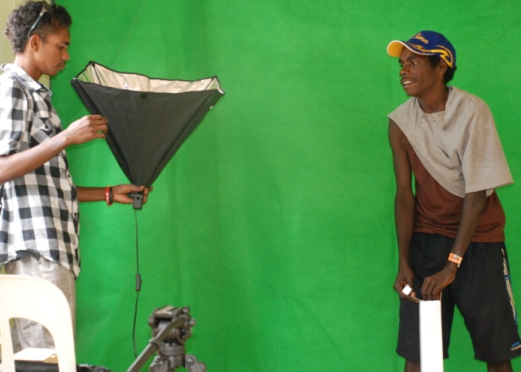
VET Program development & delivery at NTOEC
Who’s it for?
Year 9, 10 and Stage 1 students
Young adult learners
Workplace trainees
Particularly appropriate for low literacy students
not engaging with the traditional curriculum options
Highly flexible in delivery and outcomes tailored
to the particular needs/opportunities of individuals
and communities
Indigenous Communities
NTOEC has a long and effective history of delivering the Certificate II Creative Industries (Media) training package to remote communities of the Northern Territory. This involves regular workshop visits and using distance education technologies to engage and provide consistency of support to students.

Slide 3
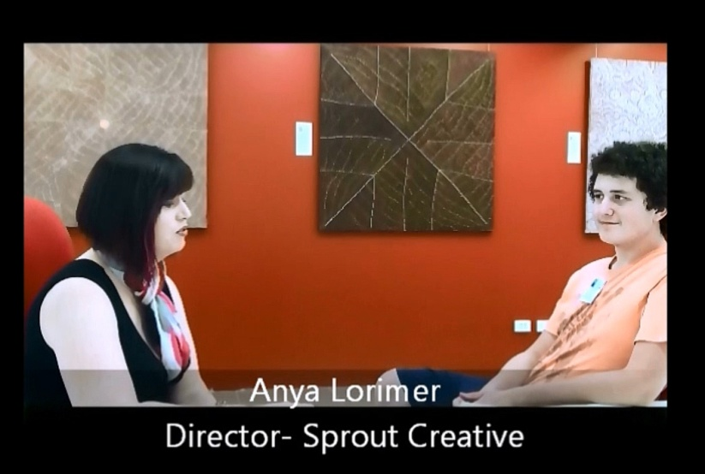
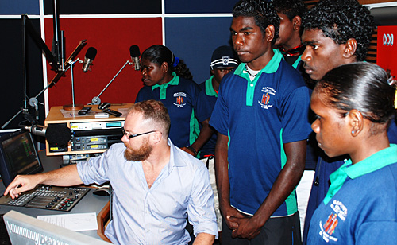
VET Program development & delivery at NTOEC
Industry Engagement
Excursions and involvement with media organisations, community events and
relevant businesses have included:
ABC studios
Local Art Centres
Sprout Interactive studio
GARMA Festivals
MusicNT
Corrugated Iron Youth Arts

Slide 4
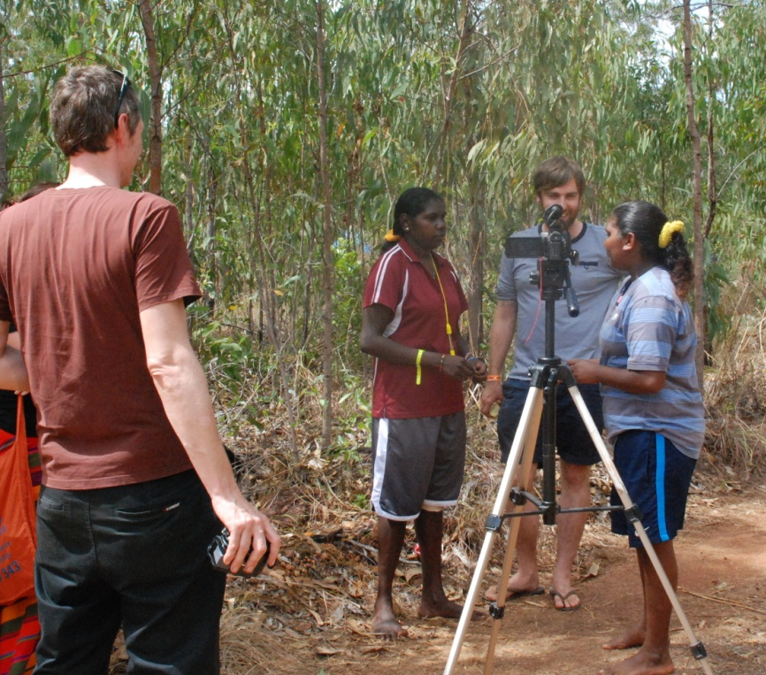
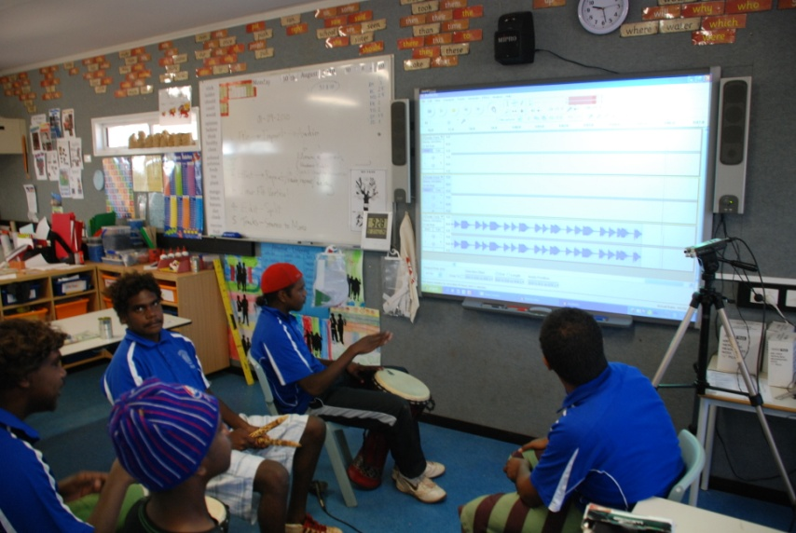
VET Program development & delivery at NTOEC
Online Learning
Teacher and Student assessment tools , checklists and guides are part of each units resource package available on CD or the Moodle LMS.
The content provides a guide for how the competencies can be achieved and is open to flexibility of contextualisation.
http://lms.ntschools.net/
Login: Username: student01.ntoec
Password: 4cheers
Enrolment key: NTOEC222

Slide 5
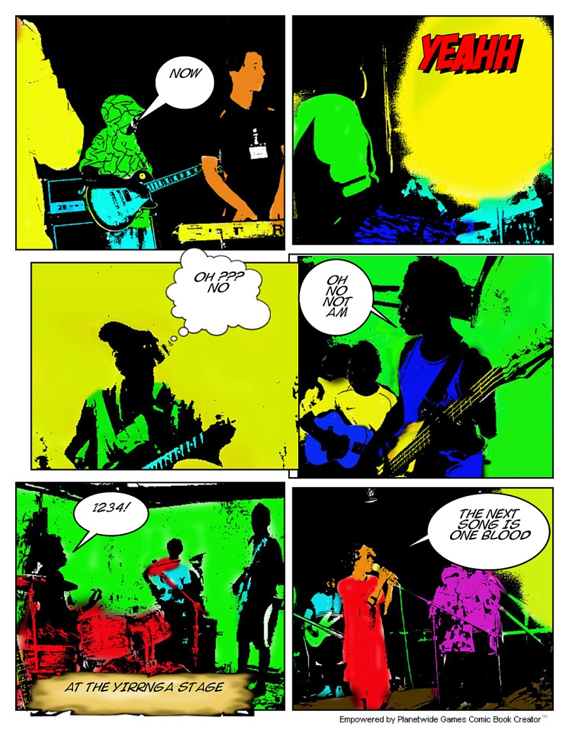

VET Program development & delivery at NTOEC
Context and low conventional literacy
Encourage story telling
Link audio & visual mediums with English
language development:
  films
  sound design & podcasts
  posters & brochures
  slide shows & galleries
  comics
Use community events
for projects
Encourage interviews/imput
with community members

Slide 6

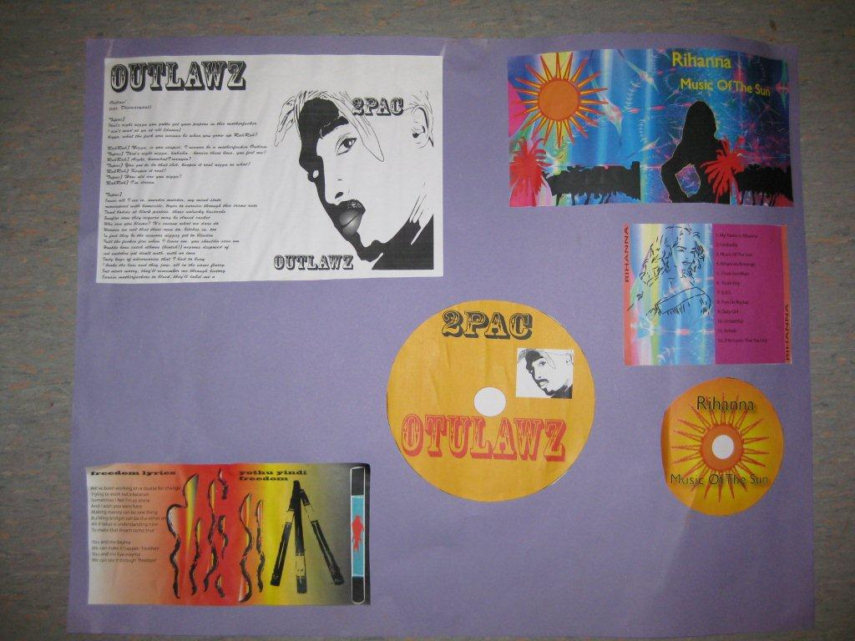

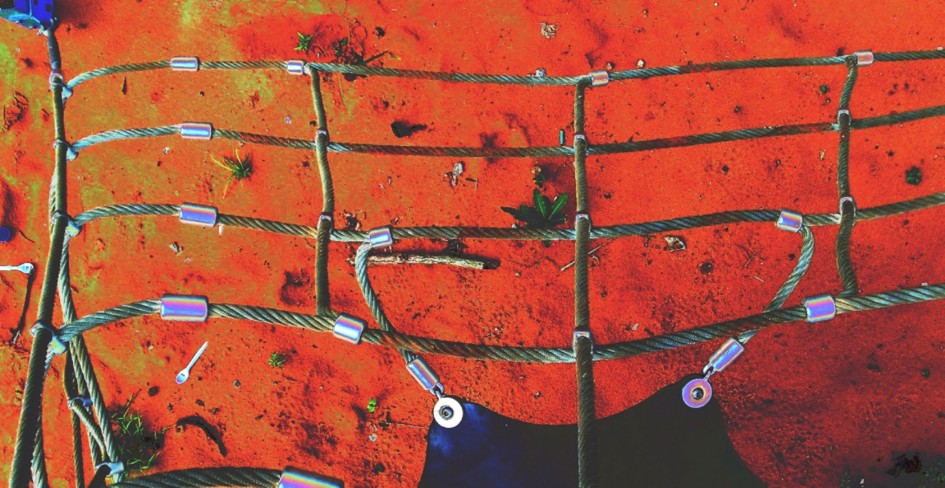
VET Program development & delivery at NTOEC
Workshop approaches
Skill based
Demonstrations
Group & individual tasks
Adapting to interests & needs

Slide 7
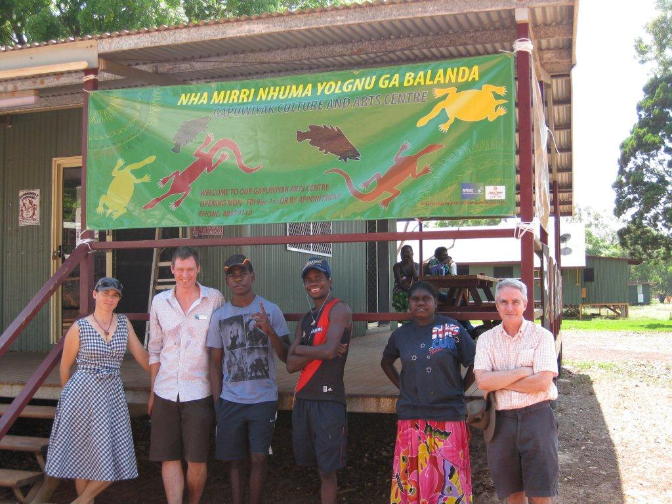

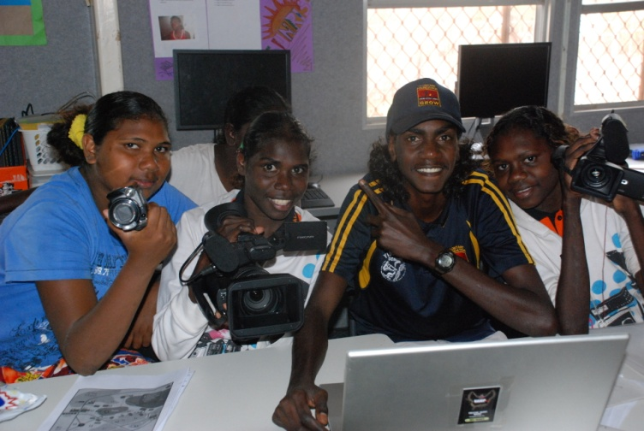
VET Program development & delivery at NTOEC
Gauging success and engagement
Educational & work pathway development
Quality student work
Increasing attendance
Establishing relationships

Slide 8
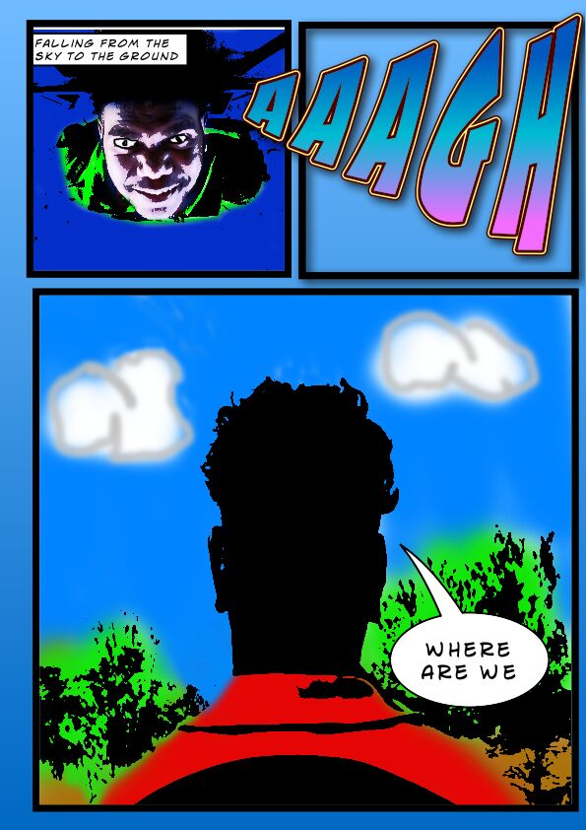

VET Program development & delivery at NTOEC
Course Pathways leading to and from VET Creative Industries
Year 10 ICT computing skills
Basic multimedia and file management
An introduction to Visual Communication (Year 10+)
Develop print design skills, media analysis and reflection
Web design (Stage 1 & 2)
Develop web design skills, incorporate audiovisual media,
Scope for blog and ePortfolio development
http://lms.ntschools.net/
Login: Username: student01.ntoec
Password: 4cheers
Enrolment key: NTOEC222

